Slide 2
PROFILE BUILDER DEEP DIVE
PRESENTED BY JASON POPE

Slide 3
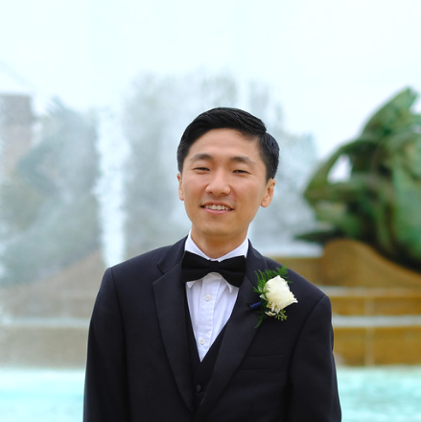
INTRODUCTION
Developer for 10+ years
4+ years at Nuix
Joined Integrated Solutions Team in 2017

Slide 4
INTRODUCTION
What is the ProfileBuilder API?
Gives the ability to programmatically build, load, and modify various Profile objects introduced in Nuix 7.6
What is a Profile?
Collection of settings and rules for a specific workflow step
What workflows have Profile objects?
Ingestion
Export
OCR
Metadata import/export
What are the benefits of Profiles?
Easy to create
Reusable
Portable – Import/export
Access via Workstation and APIs
Cleaner code

Slide 5
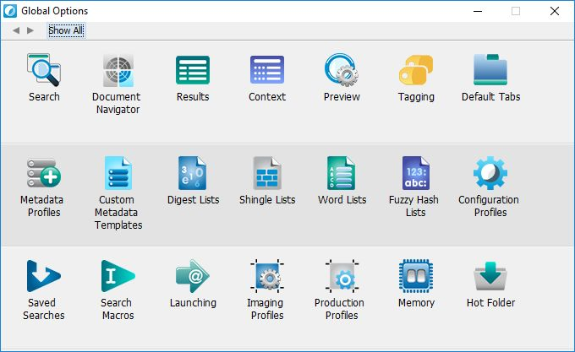
NUIX 7.2
INTRODUCTION OF PROFILES

Slide 6
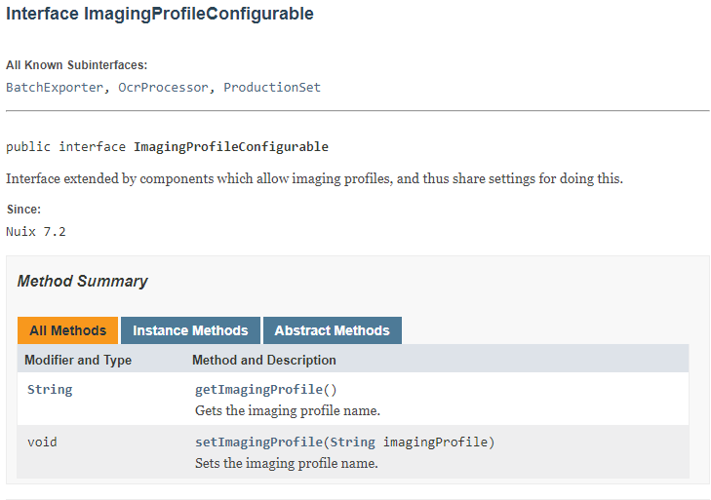
API SUPPORT
7.2 – 7.4
Limited API support
No methods to retrieve Profile Stores
UserDataStore introduced in 7.4
No Imaging or Production profile objects

Slide 7
API SUPPORT
NEW FOR 7.6
Expanded API support and functionality
New Profiles
Access to Profile objects
New utilities methods to retrieve ProfileStores
ImagingProfileStore
Metadata [Import/Export] ProfileStore
OcrProfileStore
ProcessingProfileStore
ProductionProfileStore
Introducing Builder objects
Profile
Rule
ItemCondition
Template, options, strategy, etc.

Slide 8
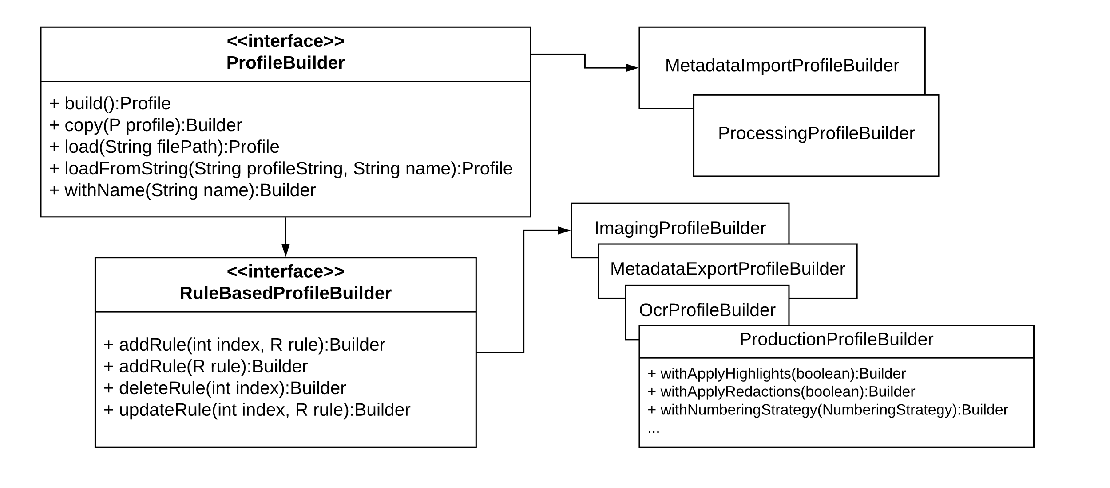
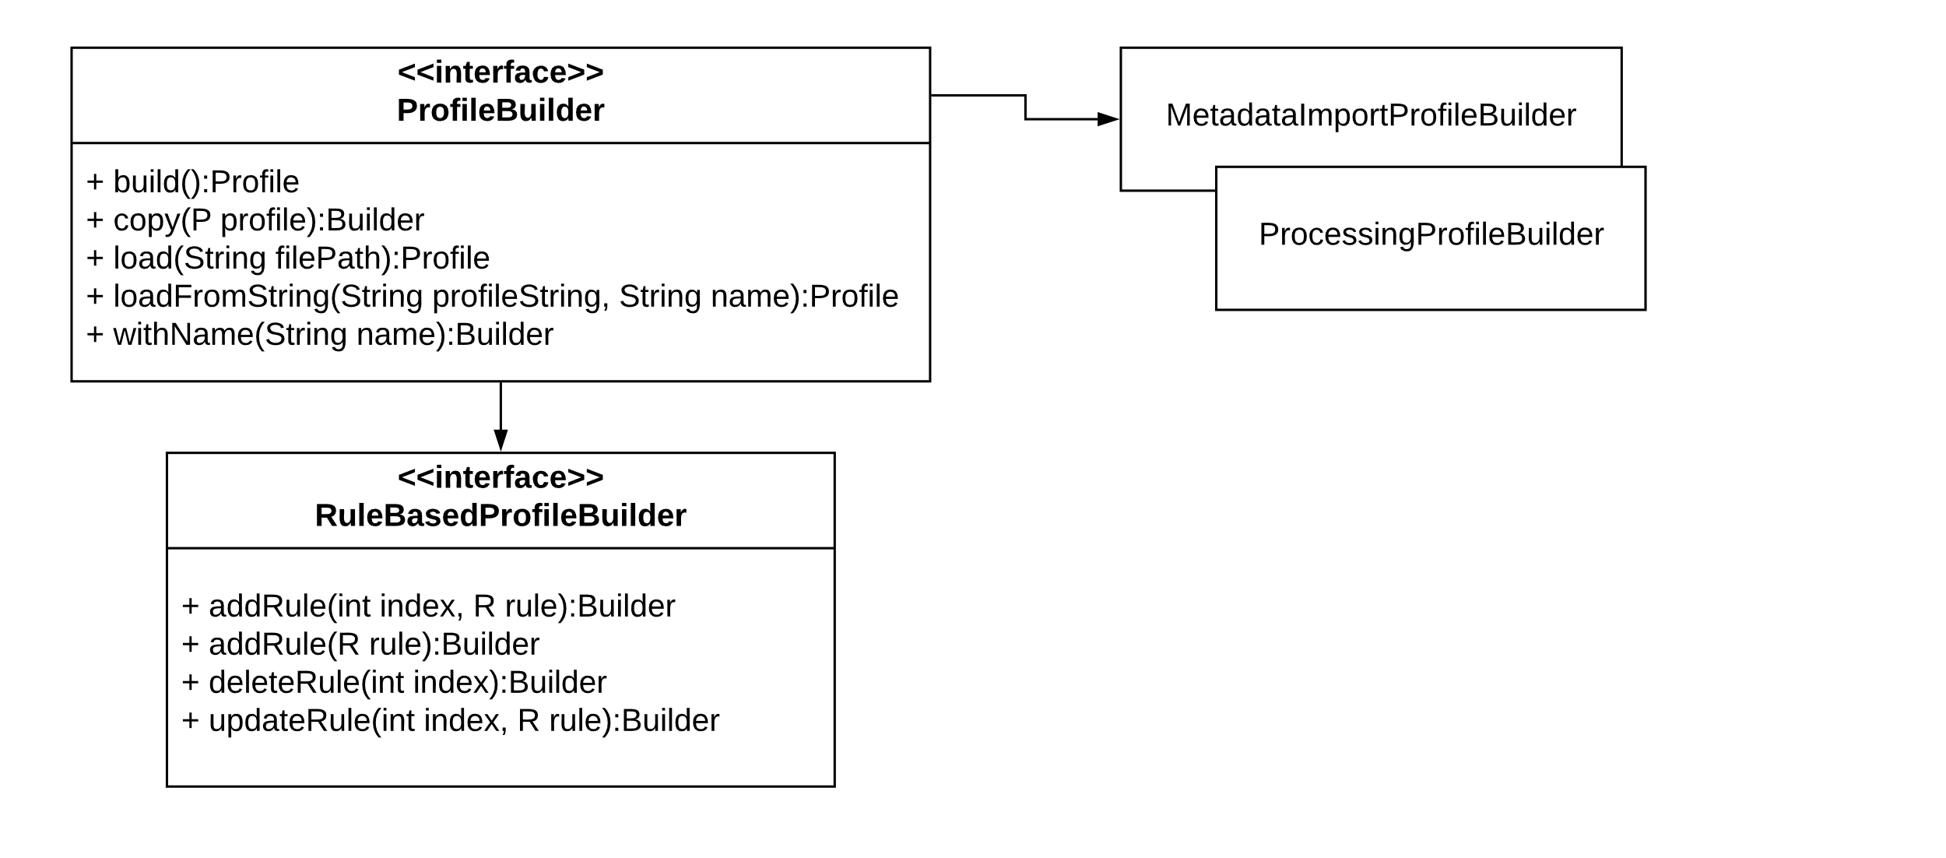
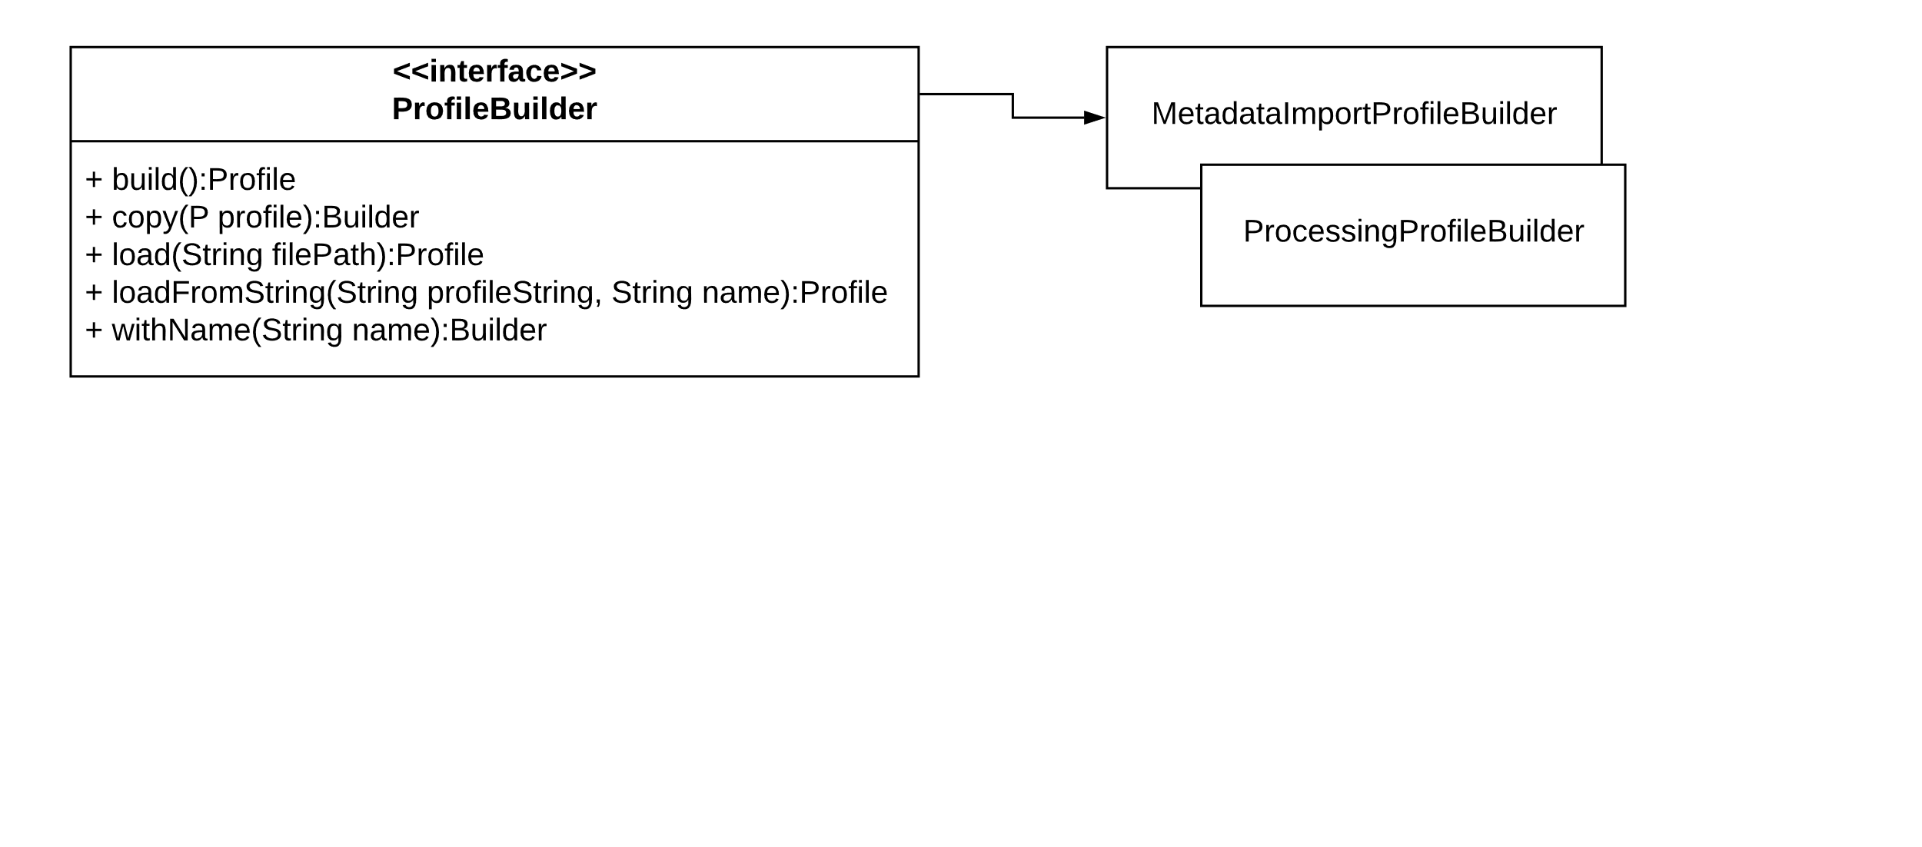
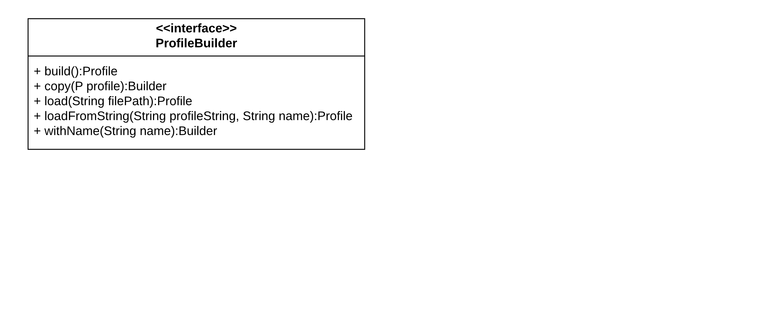
PROFILEBUILDER

Slide 9
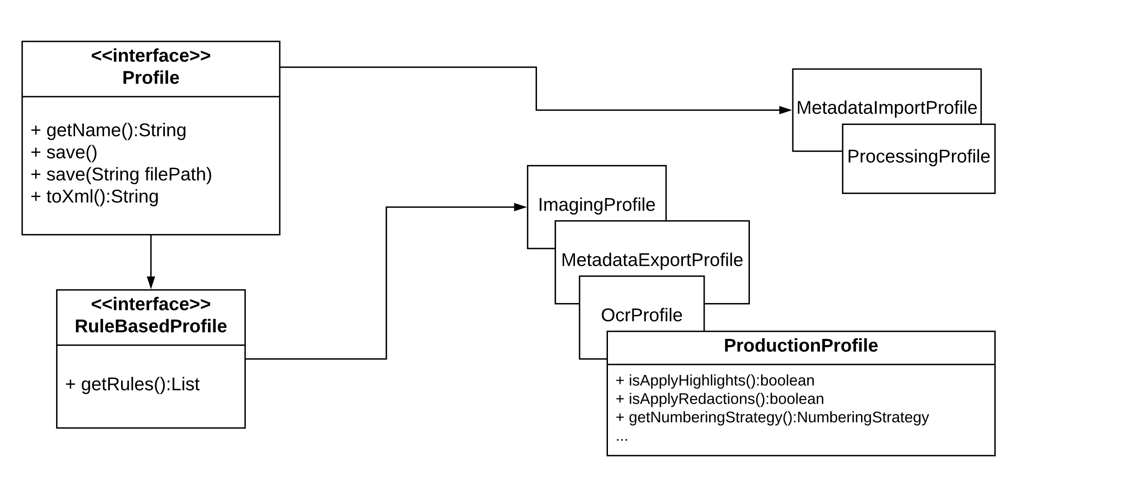
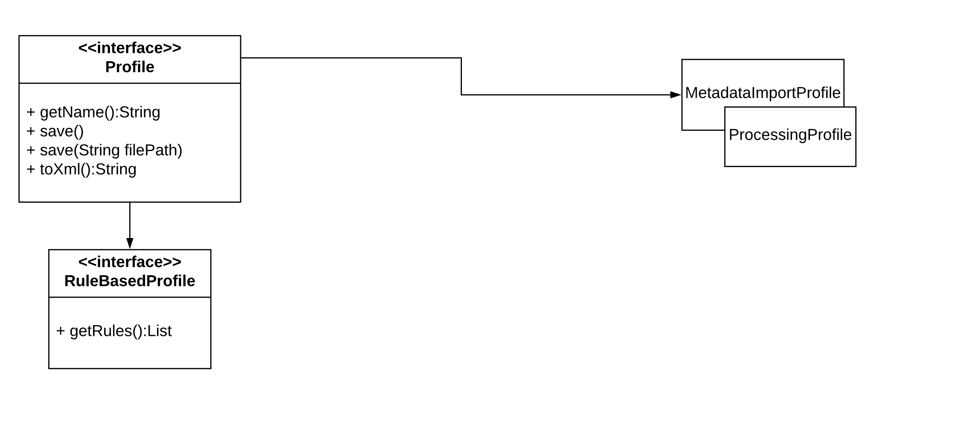
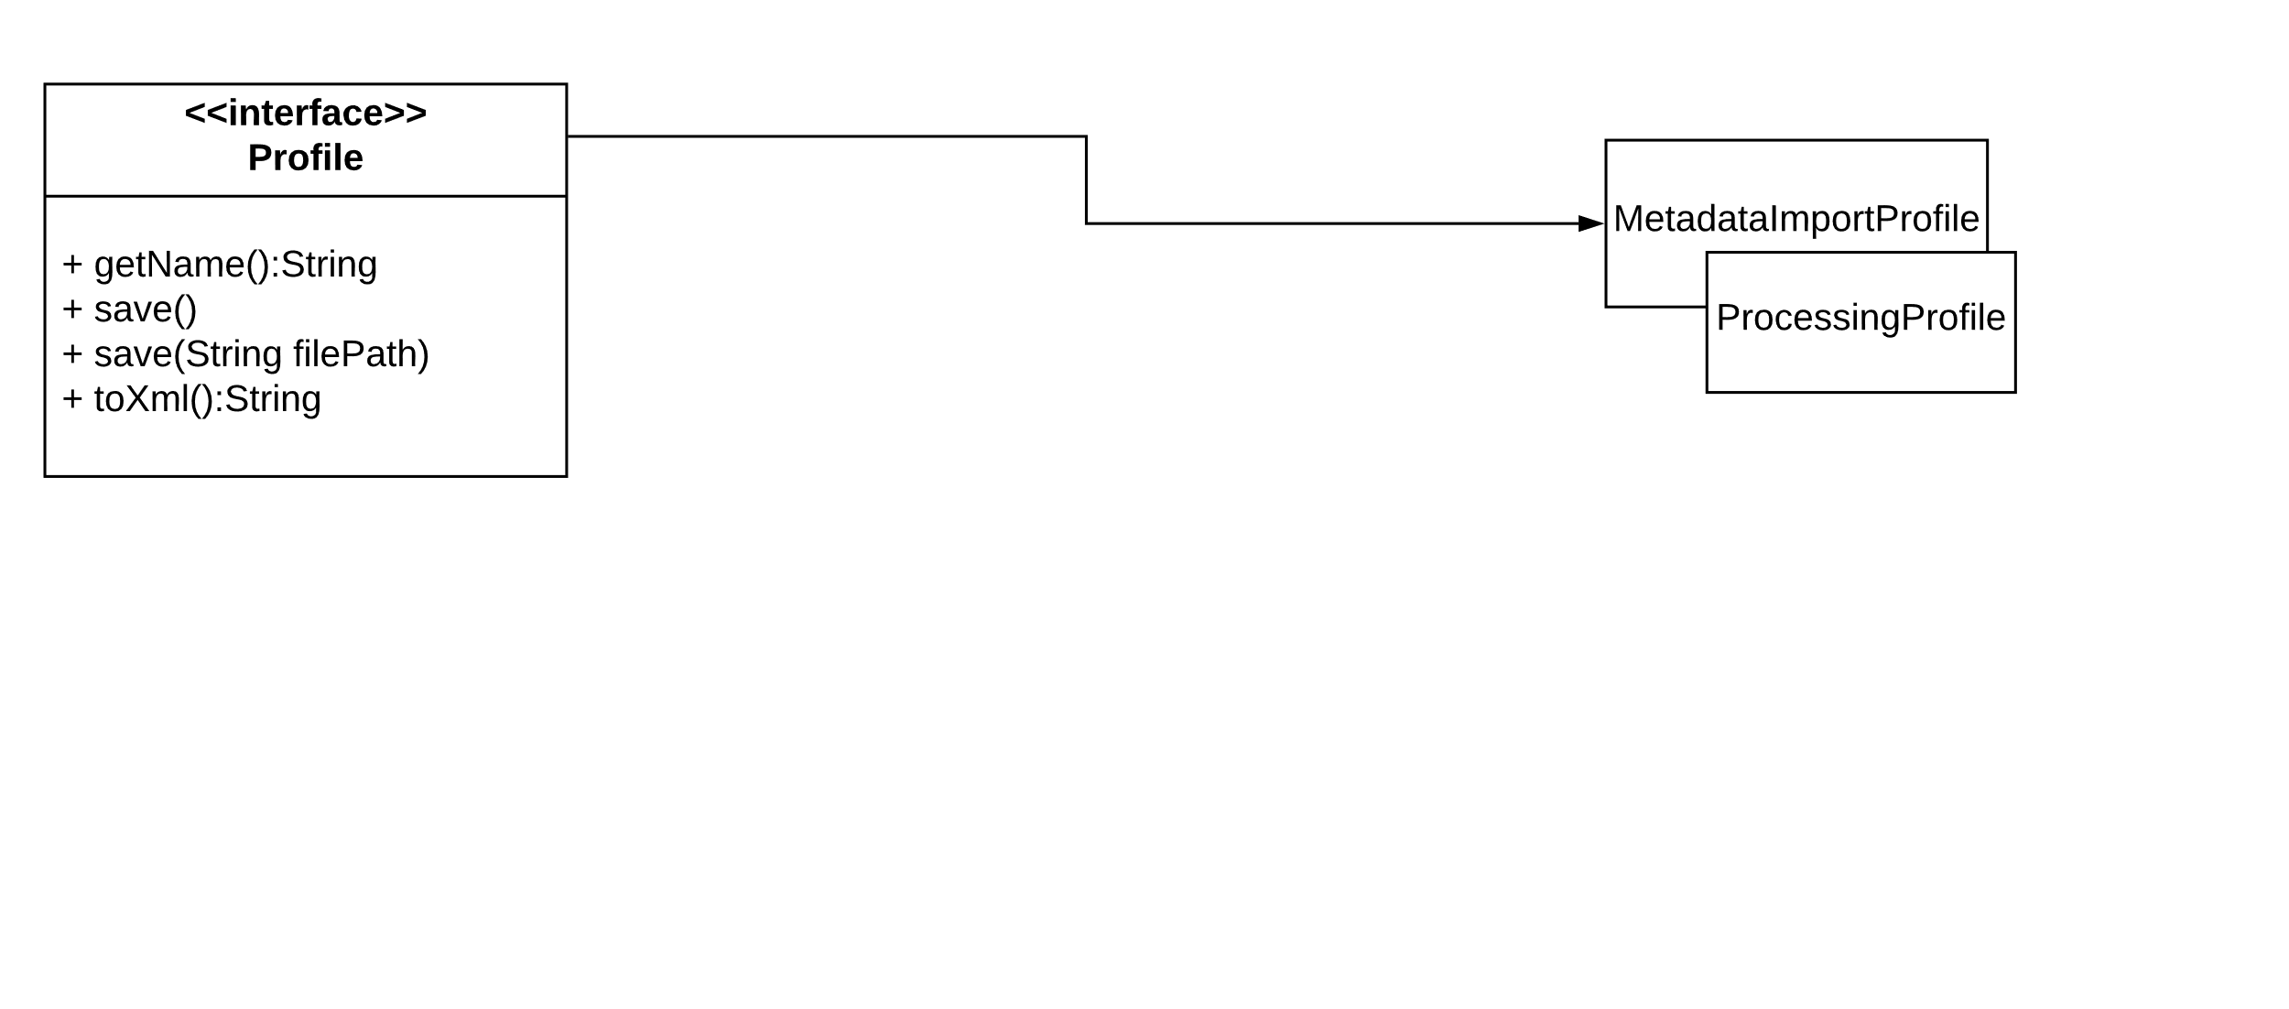
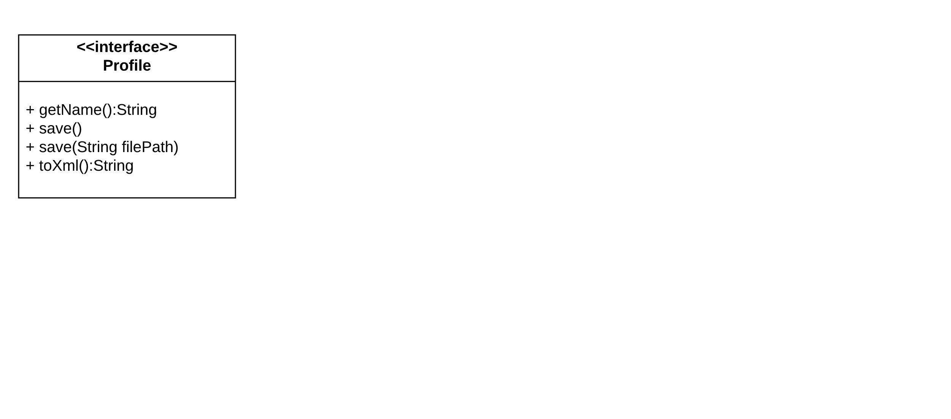
PROFILE

Slide 10
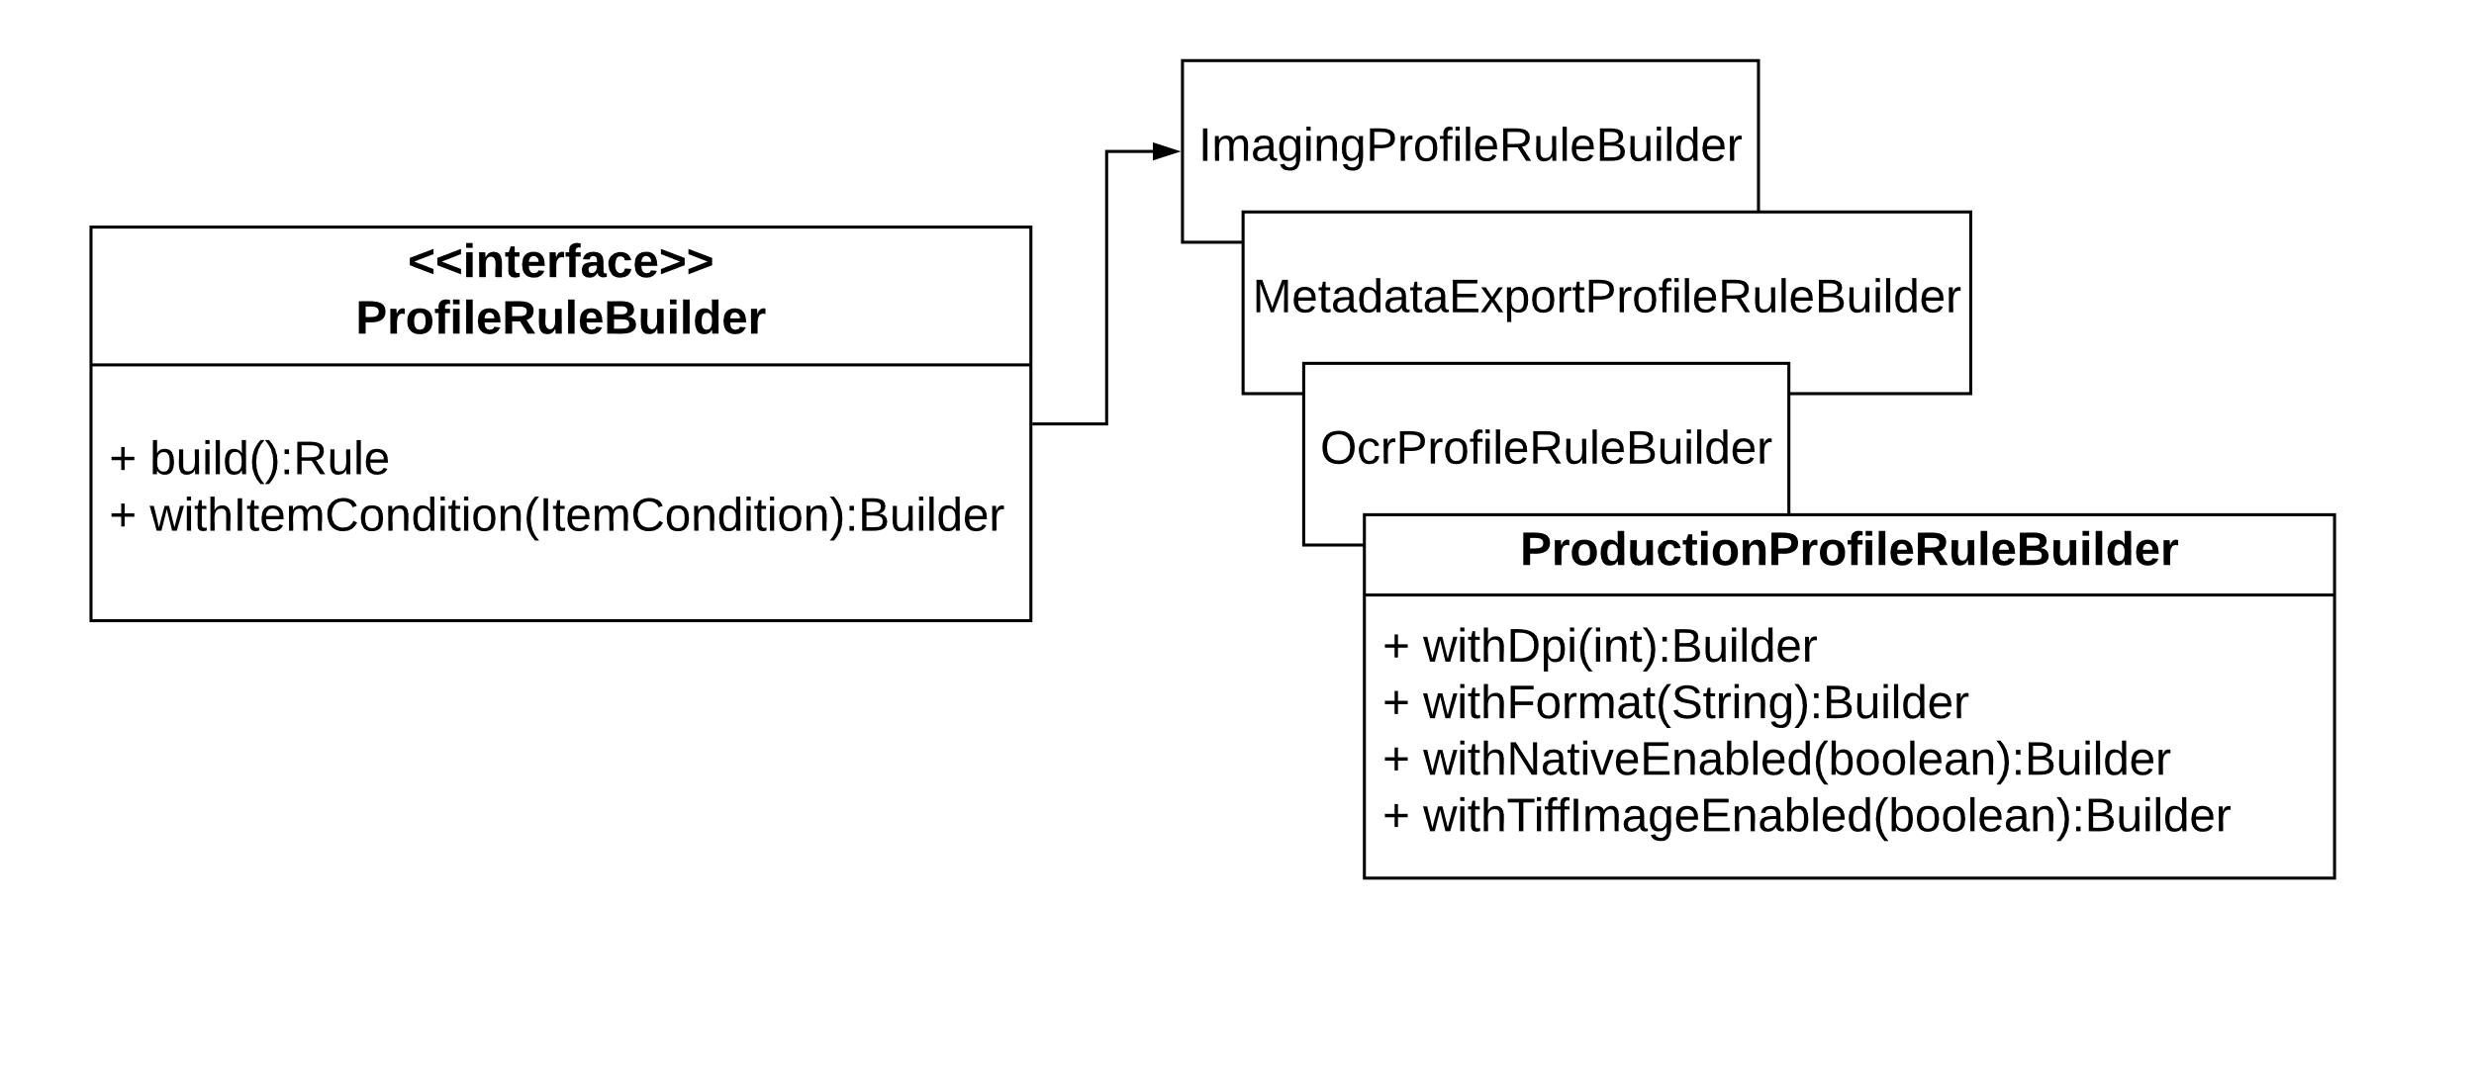
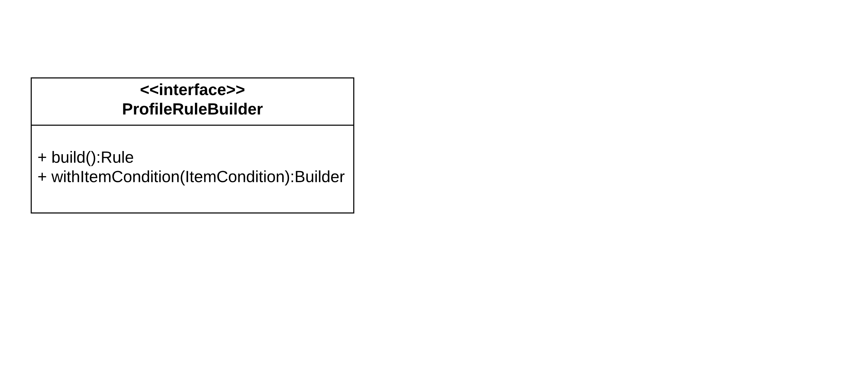
PROFILERULEBUILDER

Slide 11
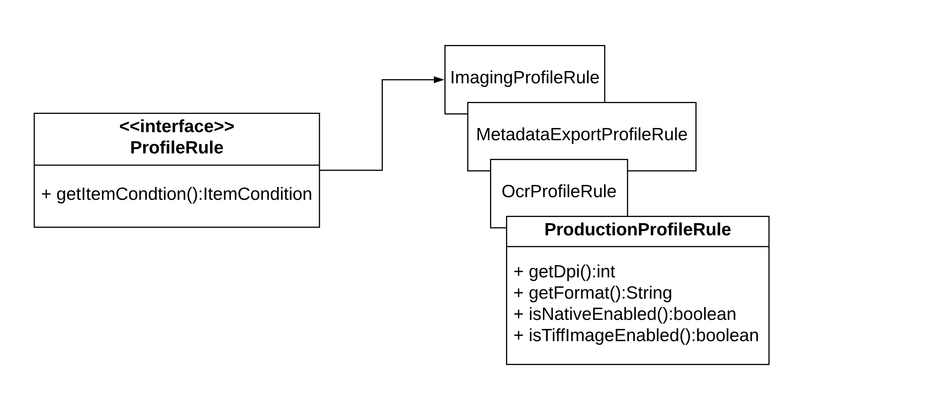
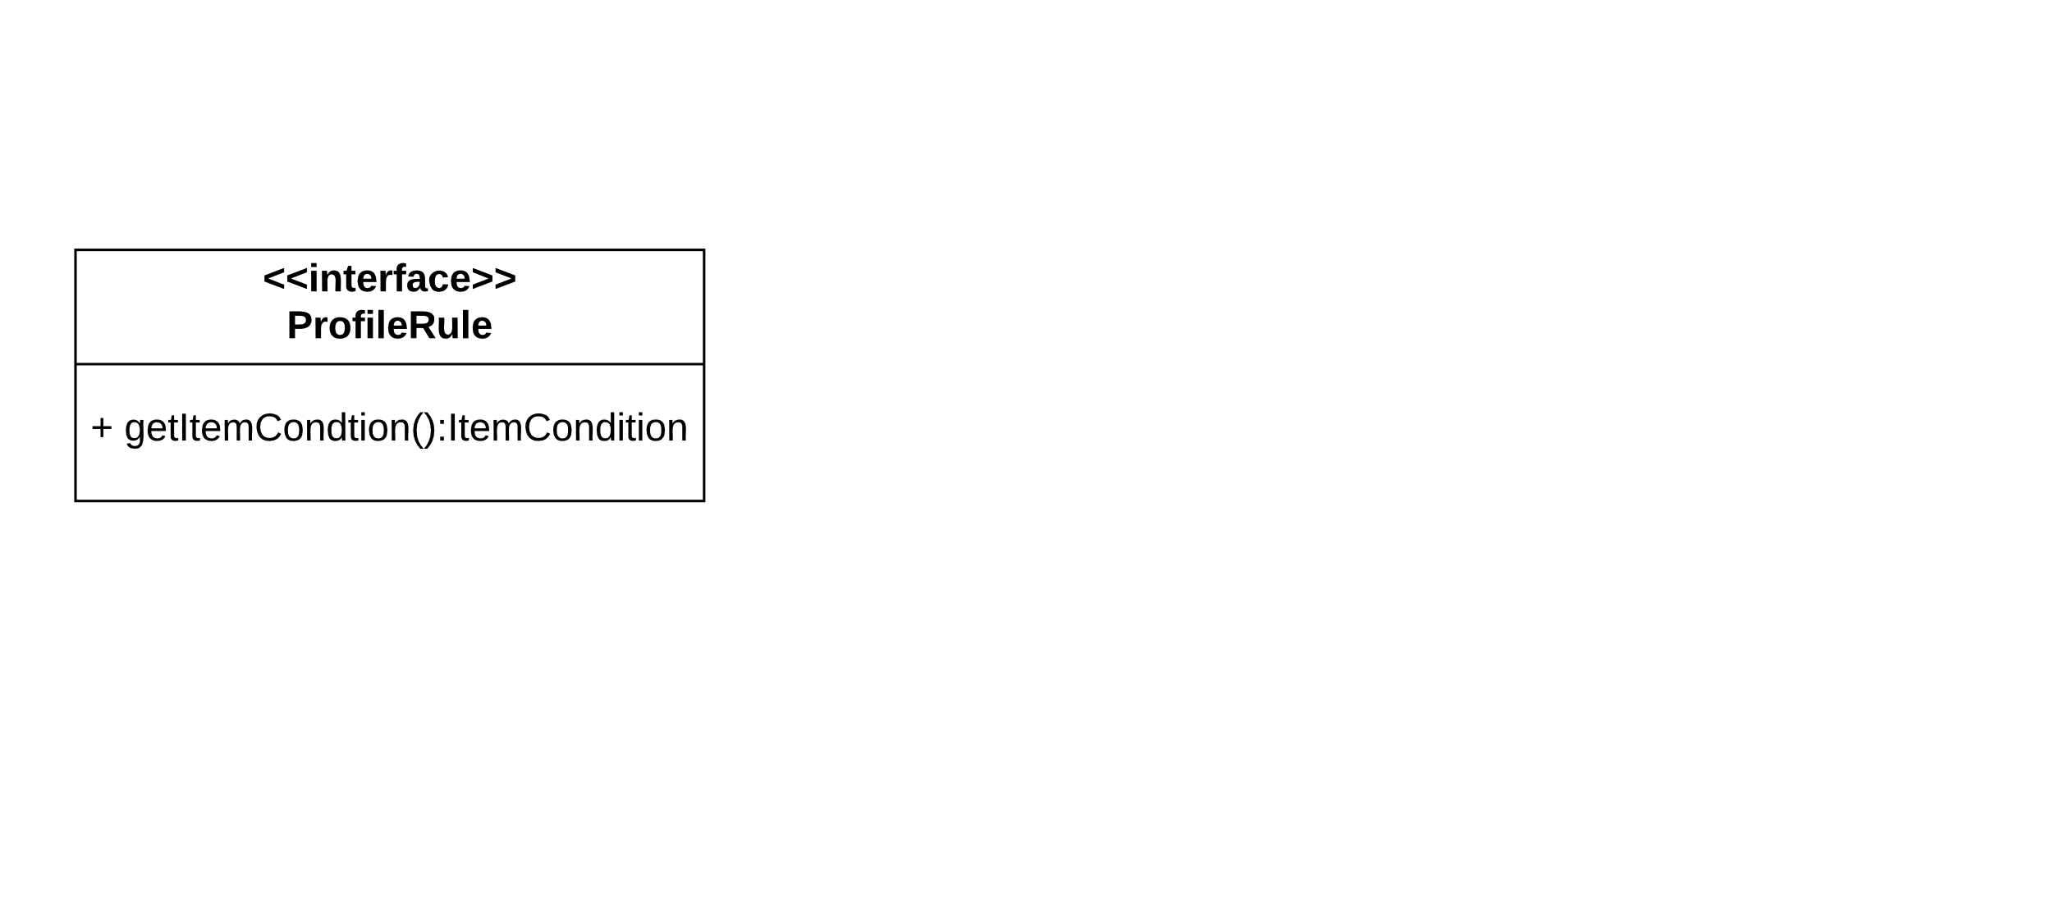
PROFILERULE

Slide 12
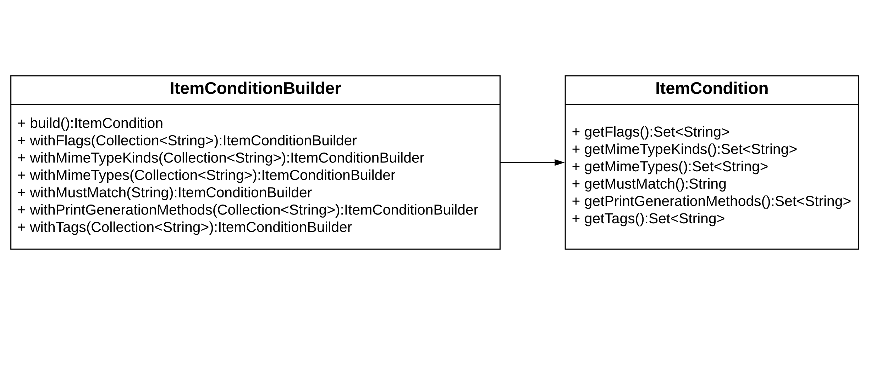
ITEMCONDITIONBUILDER AND ITEMCONDITION

Slide 13
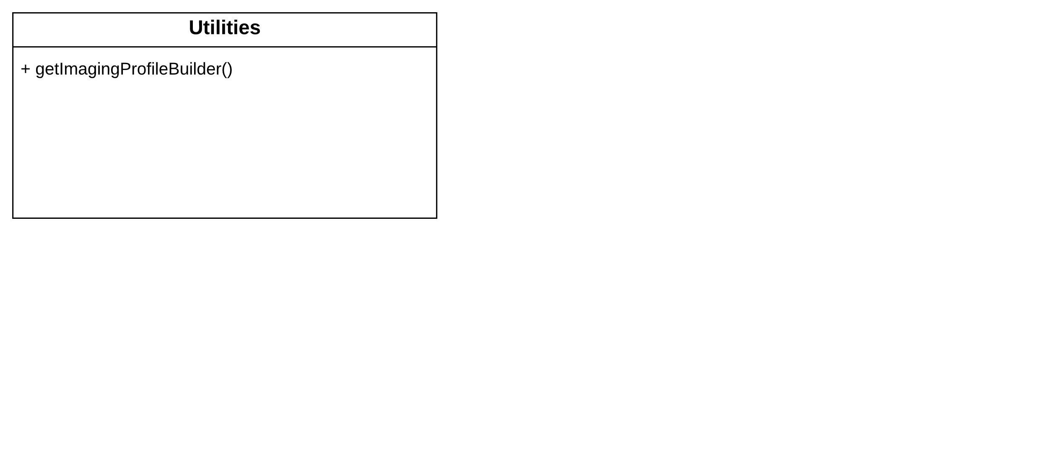
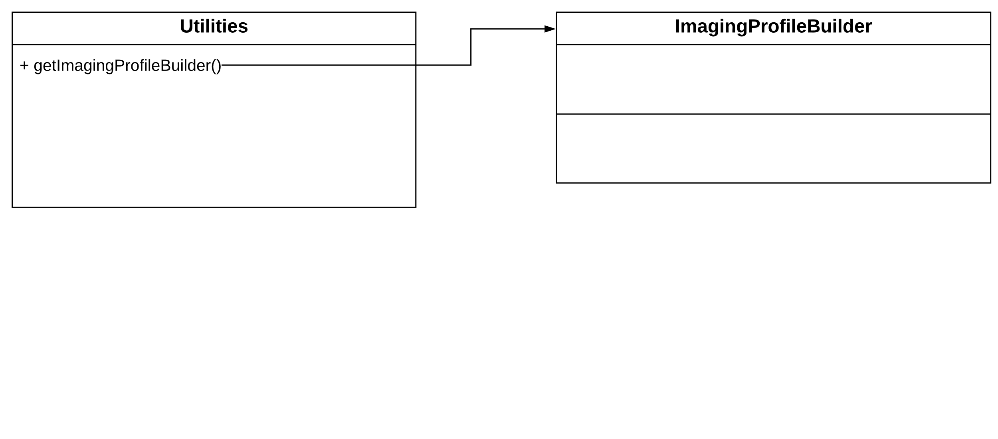
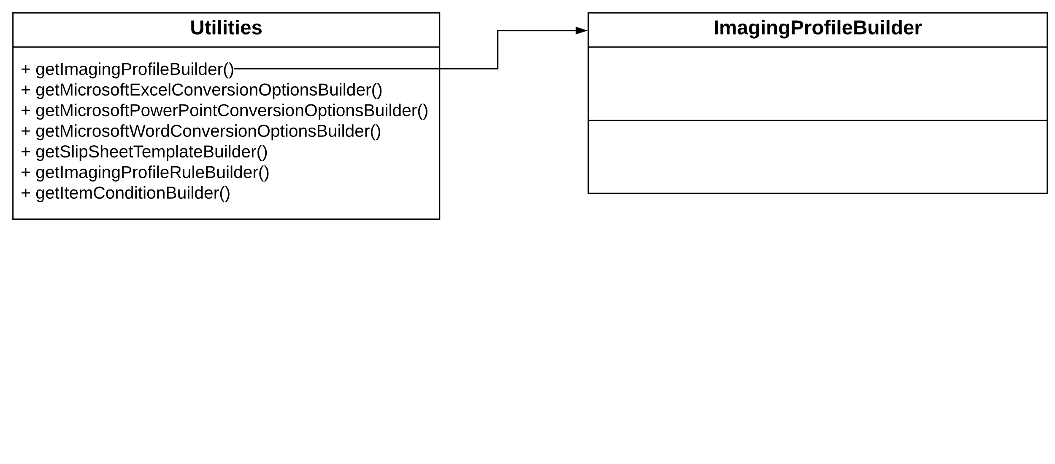
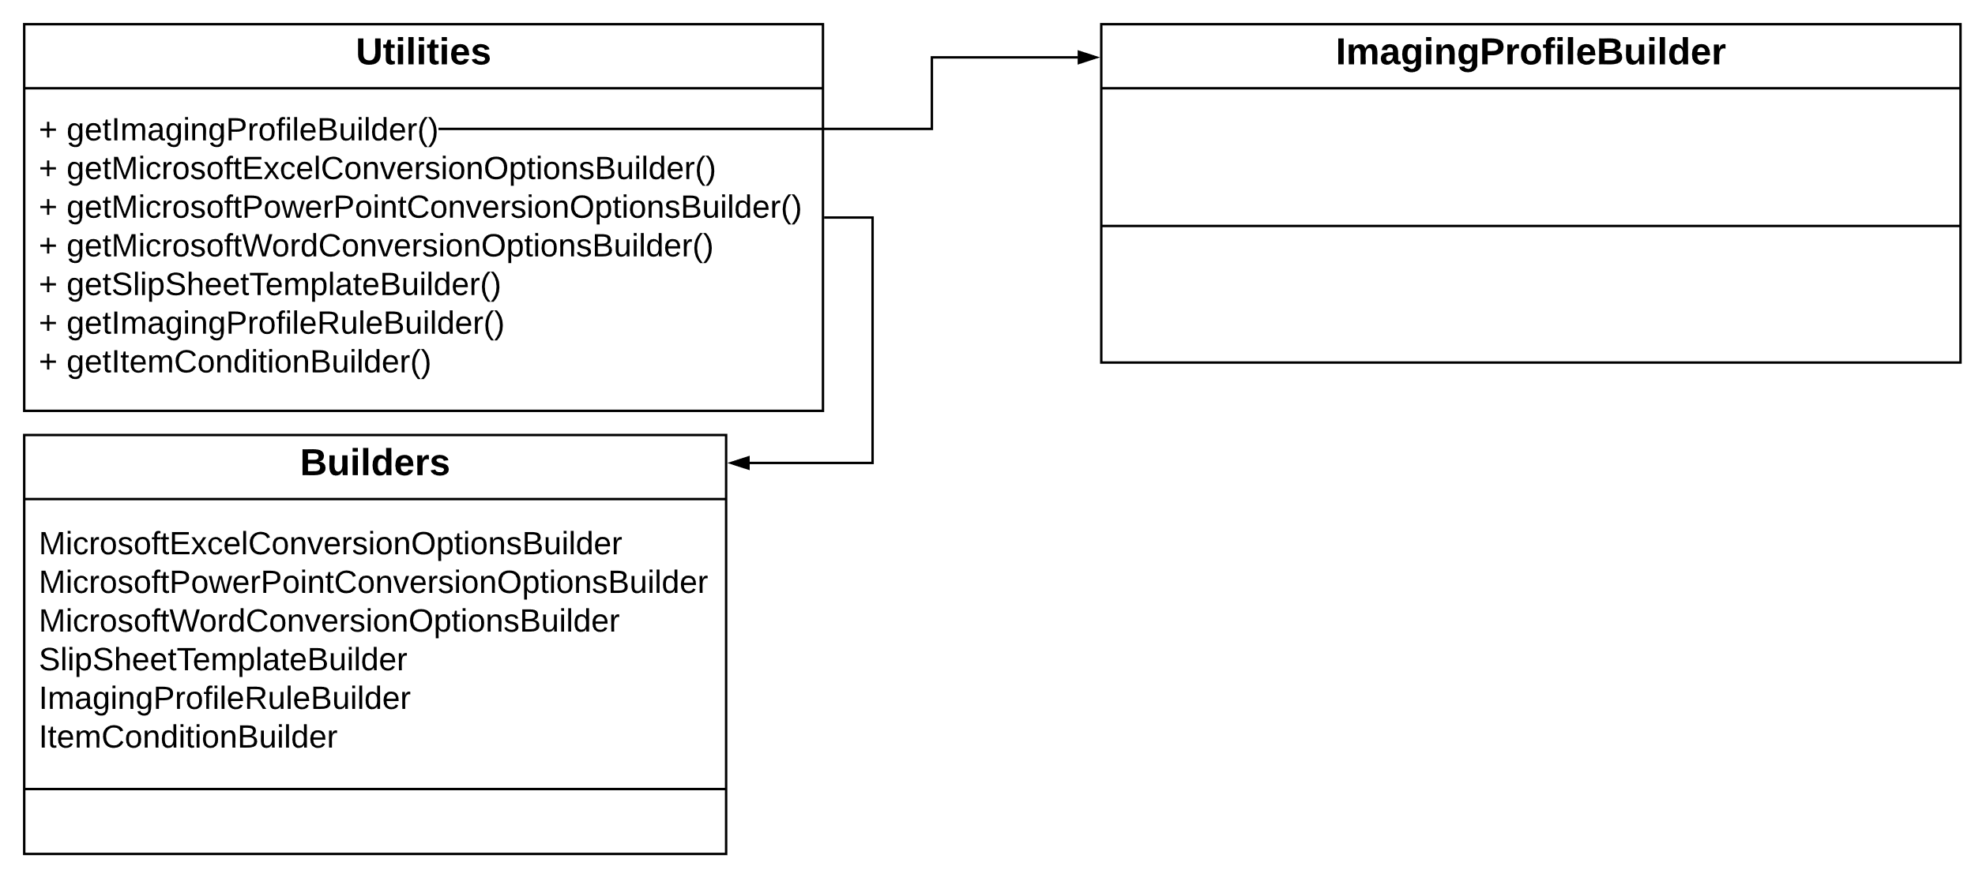
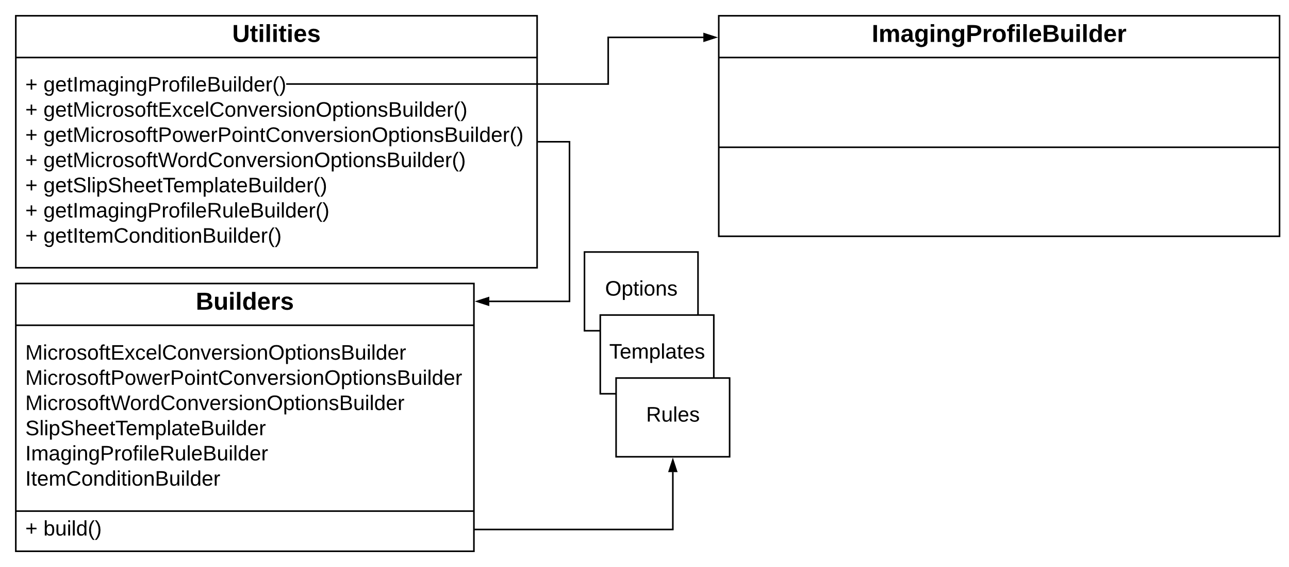
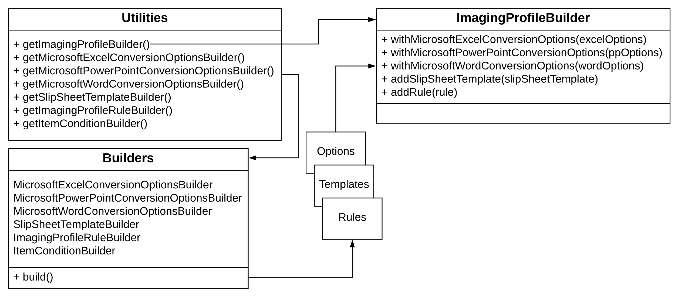
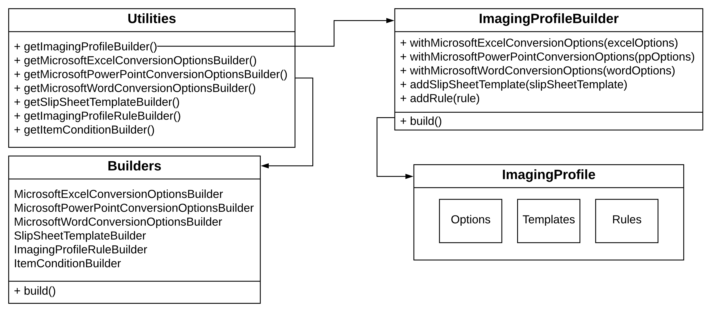
CREATING A PROFILE

Slide 14
DEMO
SCRIPTED PROFILE CREATION

Slide 15
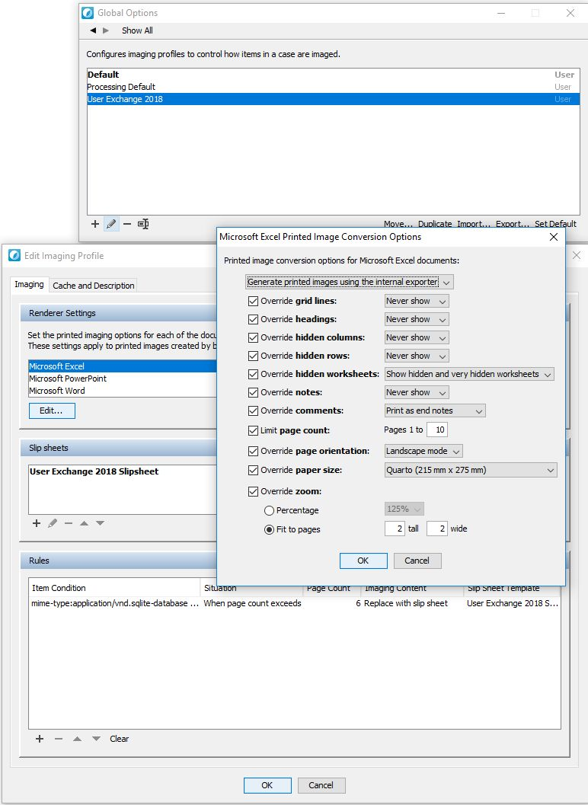
WHAT JUST HAPPENED?
SCRIPTED PROFILE CREATION REVIEW
Easy to use…
Cleaner code…
Use case?
Custom application developers

Slide 16
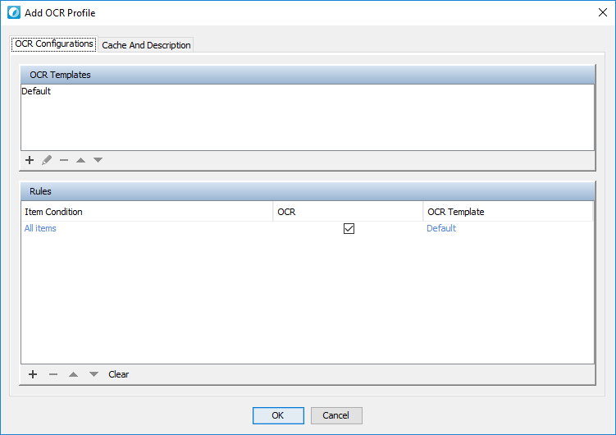
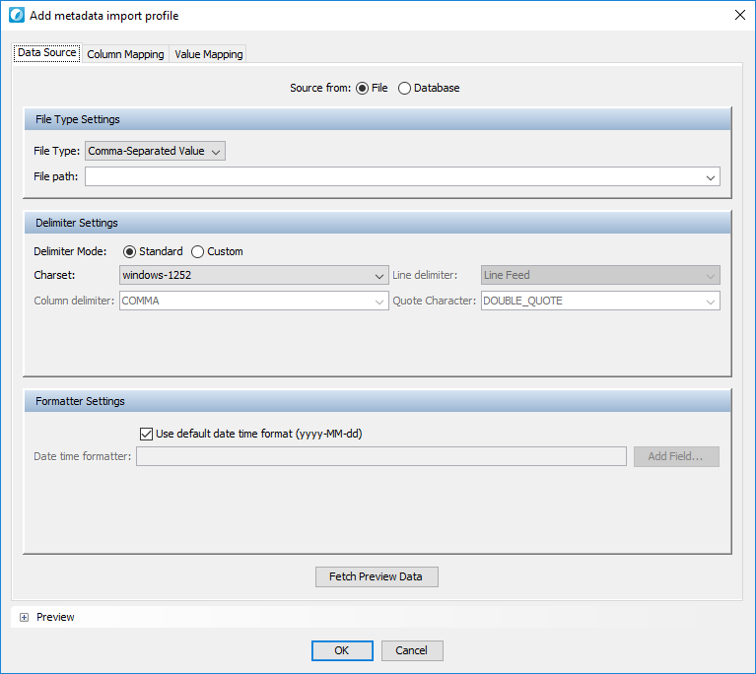
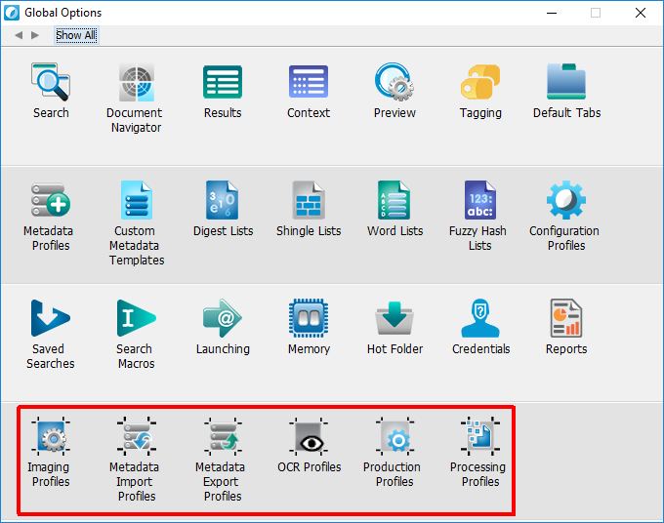
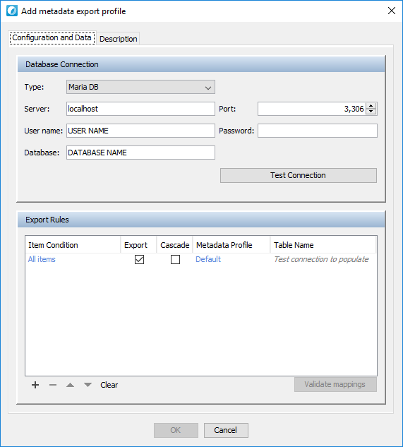
CREATING PROFILES VIA WORKSTATION

Slide 17
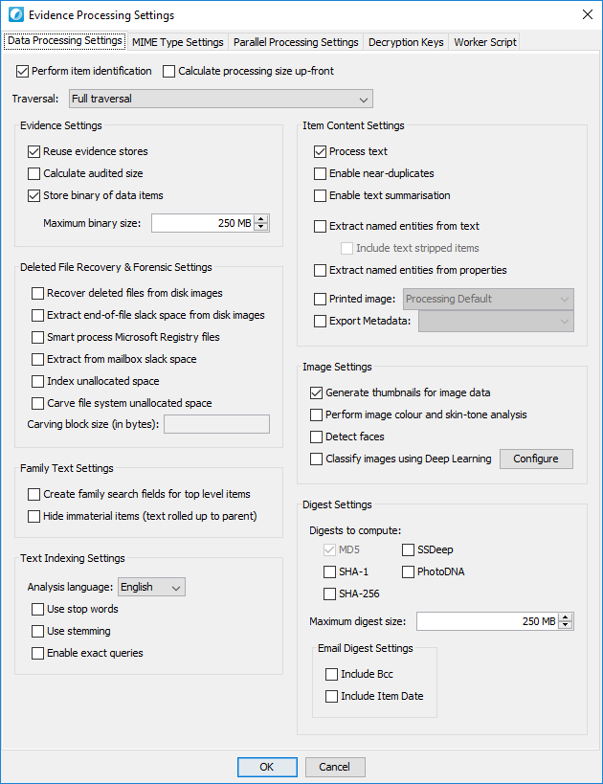
HOW CAN PROFILES CLEAN UP MY CODE?
processor.setProcessingSettings({
"processText" => true,
"traversalScope" => "full_traversal",
"processLooseFileContents" => true,
"processForensicImages" => true,
"analysisLanguage" => "en",
"stopWords" => false,
"stemming" => false,
"enableExactQueries" => false,
"extractNamedEntities" => false,
"extractNamedEntitiesFromText" => false,
"extractNamedEntitiesFromProperties" => false,
"extractNamedEntitiesFromTextStripped" => false,
"extractShingles" => true,
"processTextSummaries" => true,
…

Slide 18
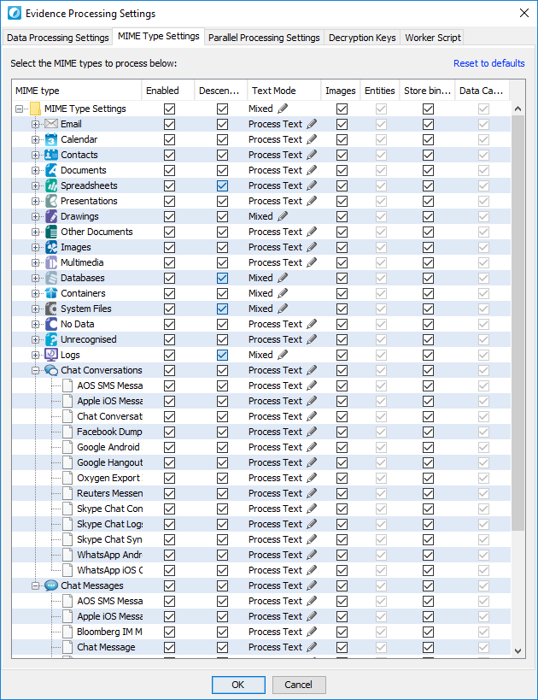
HOW CAN PROFILES CLEAN UP MY CODE?
processor.setMimeTypeProcessingSettings("text/plain", {
"enabled" => true,
"processEmbedded" => true,
"processText" => true,
#"textStrip" => false,
"processNamedEntities" => true,
"processImages" => true,
"storeBinary" => true
})
processor.setMimeTypeProcessingSettings("text/plain", {"enabled" => false})

Slide 19
HOW CAN PROFILES CLEAN UP MY CODE?
processor.setProcessingProfile("My Awesome Profile")

Slide 20
DEMO
BUILDING PROFILES FROM EXISTING SCRIPTS

Slide 21
PROFILE MANAGEMENT

Slide 22
PROFILE MANAGEMENT
MANAGEMENT
# ProfileStore
processingProfileStore = $utilities.getProcessingProfileStore
# Retrieve Collection<String> of profile names in store
processingProfileStore.getProfileNames
# Check if a store contains a profile
processingProfileStore.containsProfile("User Exchange 2018")
# Delete a profile
processingProfileStore.deleteProfile("User Exchange 2018")

Slide 23
PROFILE MANAGEMENT
EXPORT, IMPORT, DUPLICATION
# Export - Saves profile to file system as XML
profileStore.exportProfile("User Exchange 2018", "/path/to/export", "UE 2018 Exported")
# Import - Loads and adds profile from XML into profile store
importedProfile = profileStore.importProfile("/path/to/profile.xml", "UE 2018 Imported")
# Duplicate - Creates a working copy of an existing profile
profile = profileStore.getProfile("User Exchange 2018")
duplicatedProfile = profileStore.duplicateProfile(profile, "Duplicated Profile")

Slide 24
PROFILE MANAGEMENT
MANAGEMENT
# ProfileBuilder
# Copy - Copies settings from Profile object into a ProfileBuilder
profile = profileStore.getProfile("User Exchange 2018")
builder = $utilities.getProcessingProfileBuilder
builder.copy(profile)
# Load - Creates a Profile object from XML
builder = $utilities.getProcessingProfileBuilder
profile = builder.load("/path/to/profile.xml")

Slide 25
DEMO
MODIFYING EXISTING PROFILES

Slide 26
WORKER SIDE SCRIPTING
MADE EASY

Slide 27
WORKER SIDE SCRIPTING
# Define the WSS ruby source as a multi line string inline to the main Ruby script
worker_side_script_code = <<CODE
# Define our worker item callback
def nuix_worker_item_callback(worker_item)
# Get the associated SourceItem
source_item = worker_item.getSourceItem
# Use the source item to get the kind
kind = source_item.getKind.getName
# Apply kind as custom metadata
worker_item.add_custom_metadata("Item Kind", kind, "text", "user")
end
CODE
processing_settings = {
# Other settings here...
"workerItemCallback" => "ruby:"+worker_side_script_code,
# Other settings here...
}

Slide 28
WORKER SIDE SCRIPTING
# Define path to a file containing worker side script code
path_to_wss = 'C:\NuixStuff\MyWorkerSideScriptCode.rb'
worker_side_script_code = File.read(path_to_wss)
# Define our settings Hash
processing_settings = {
# Other settings here...
"workerItemCallback" => "ruby:"+worker_side_script_code,
# Other settings here...
}
processor.setProcessingSettings(processing_settings)

Slide 29
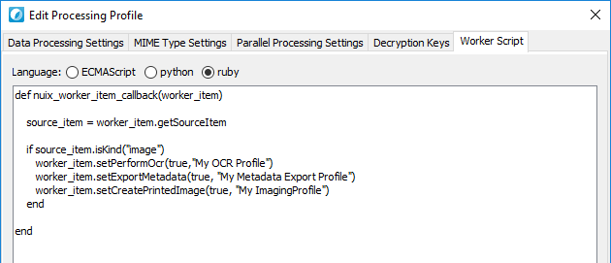
WORKER SIDE SCRIPTING

Slide 30
LET’S REVIEW

Slide 31
Review
What?
ProfileBuilderAPI
Framework for profile creation and management
Profiles
Objects that encapsulate settings for workflows
Builders
Helpers to configure profiles, rules, etc.
Rules, Conditions, etc
Profile specific refinement
Who?
Custom application developers
Scripters
Workstation users
Where?
Workstation
APIs
When?
Processing, Export, OCR, Metadata Import/Export
Templated workflows
Why?
Save time
Reduce errors
Reproducible results
Easy and convenient
Cleaner code

Slide 32
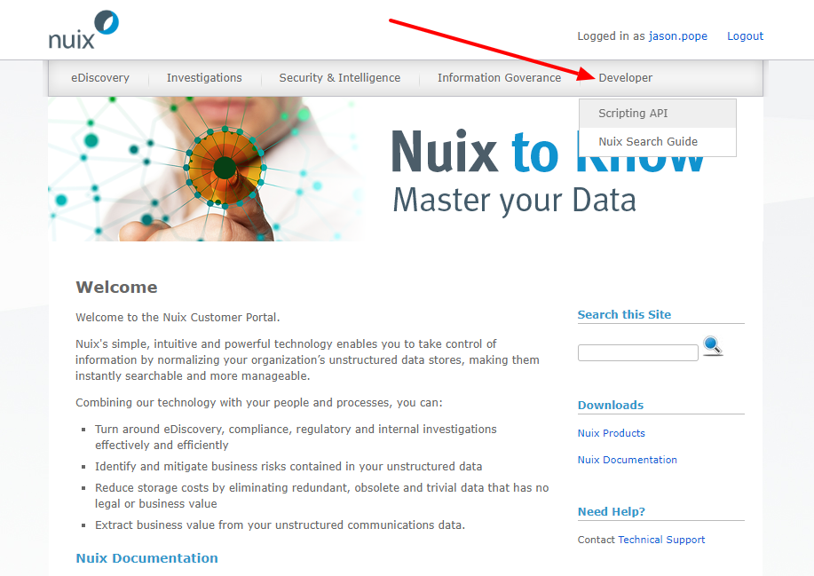
LEARN MORE
API DOCUMENTATION
Online
https://download.nuix.com/
Workstation
C:\Program Files\Nuix\Nuix 7.6\doc\index.html
Engine
/{engine_dir}/doc/api/index.html
Support
https://nuix.service-now.com/support

Slide 33
QUESTIONS?

Slide 34
THANK YOU!
DON’T FORGET TO TAKE THE SESSION SURVEY

